Slide 1

Chapter 11
User Datagram
Protocol
Objectives
Upon completion you will be able to:
Be able to explain process-to-process communication
Know the format of a UDP user datagram
Be able to calculate a UDP checksum
Understand the operation of UDP
Know when it is appropriate to use UDP
Understand the modules in a UDP package

Slide 2
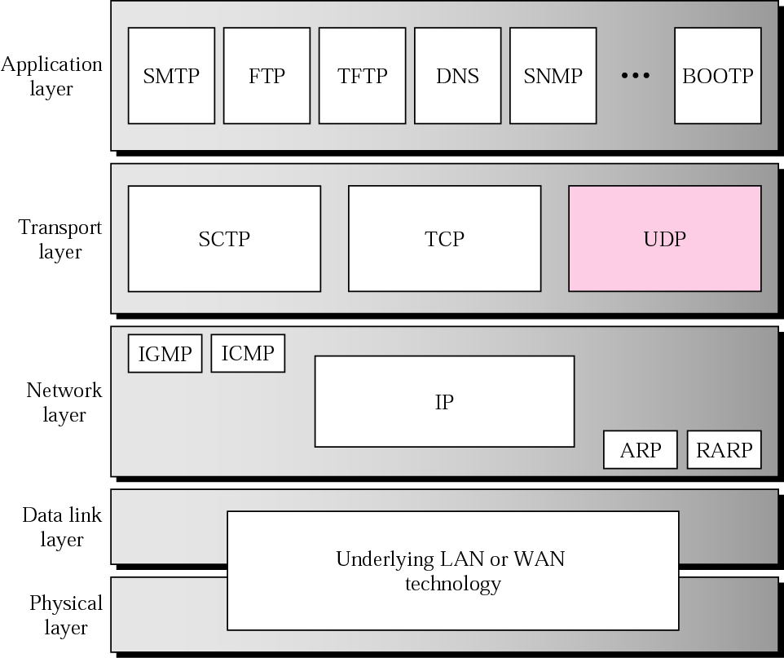
Figure 11.1 Position of UDP in the TCP/IP protocol suite

Slide 3
11.1 PROCESS-TO-PROCESS
COMMUNICATION
Before we examine UDP, we must first understand host-to-host communication and process-to-process communication and the difference between them.
The topics discussed in this section include:
Port Numbers
Socket Addresses

Slide 4
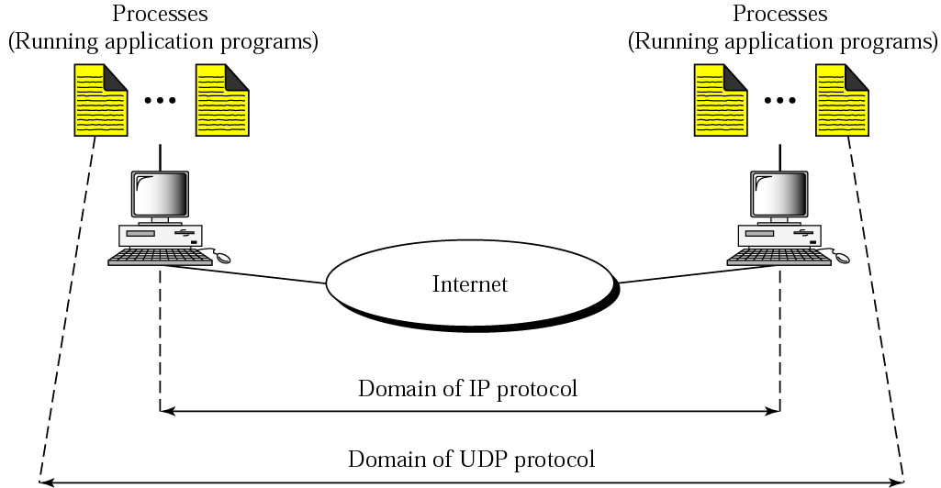
Figure 11.2 UDP versus IP

Slide 5
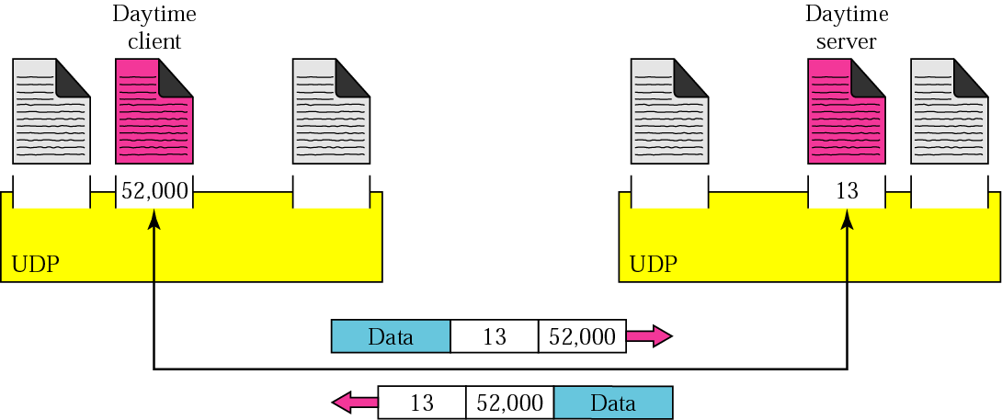
Figure 11.3 Port numbers

Slide 6
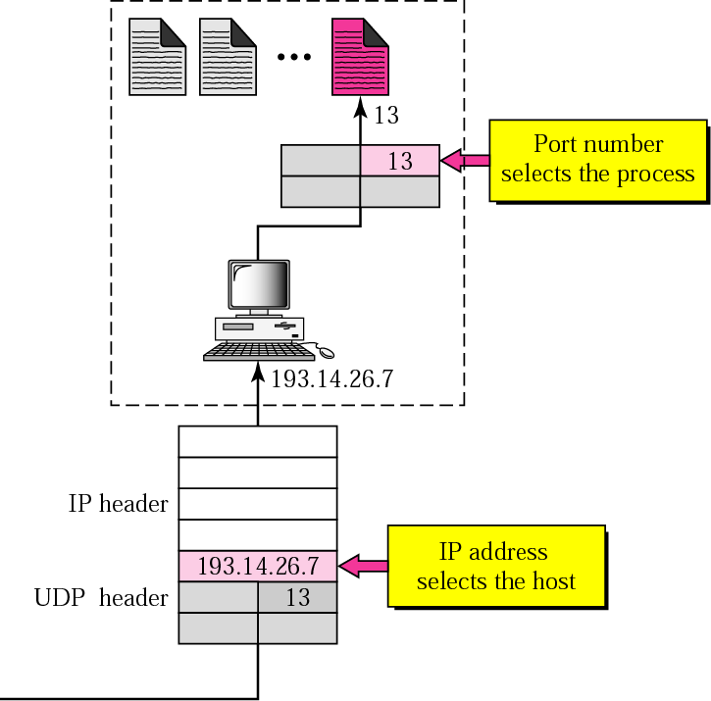
Figure 11.4 IP addresses versus port numbers

Slide 7
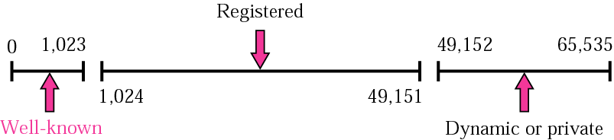
Figure 11.5 ICANN ranges

Slide 8

Note:
The well-known port numbers are less than 1024.

Slide 9
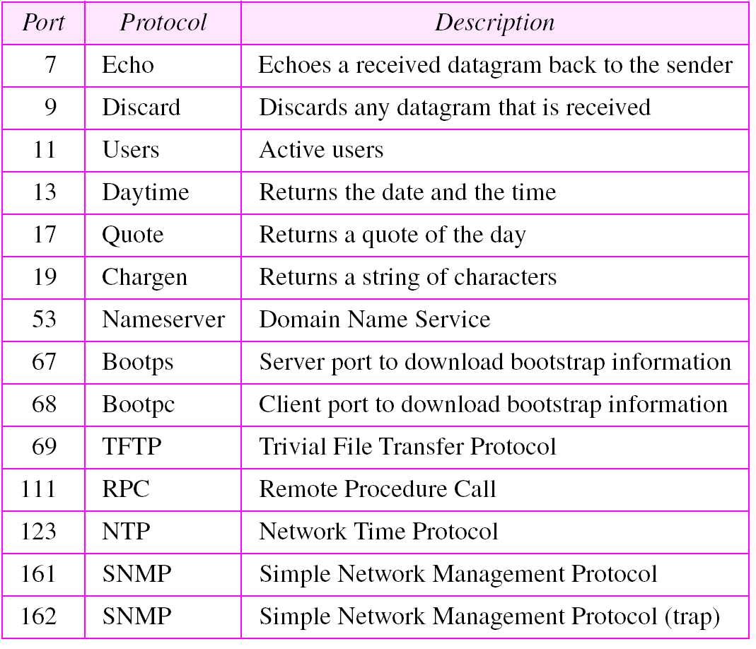
Table 11.1 Well-known ports used with UDP

Slide 10
Example 1
In UNIX, the well-known ports are stored in a file called /etc/services. Each line in this file gives the name of the server and the well-known port number. We can use the grep utility to extract the line corresponding to the desired application. The following shows the port for TFTP. Note TFTP can use port 69 on either UDP or TCP.
$ grep tftp /etc/services
tftp 69/tcp
tftp 69/udp
See Next Slide

Slide 11
Example 1 (Continued)
SNMP uses two port numbers (161 and 162), each for a different purpose, as we will see in Chapter 21.
$ grep snmp /etc/services
snmp 161/tcp #Simple Net Mgmt Proto
snmp 161/udp #Simple Net Mgmt Proto
snmptrap 162/udp #Traps for SNMP

Slide 12
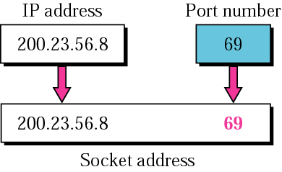
Figure 11.6 Socket address

Slide 13
11.2 USER DATAGRAM
UDP packets are called user datagrams and have a fixed-size header of 8 bytes.

Slide 14
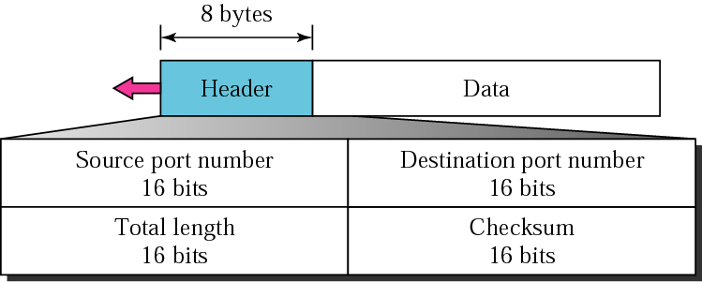
Figure 11.7 User datagram format

Slide 15
Note:
UDP length =
IP length − IP header’s length

Slide 16
11.3 CHECKSUM
UDP checksum calculation is different from the one for IP and ICMP. Here the checksum includes three sections: a pseudoheader, the UDP header, and the data coming from the application layer.
The topics discussed in this section include:
Checksum Calculation at Sender
Checksum Calculation at Receiver
Optional Use of the Checksum

Slide 17
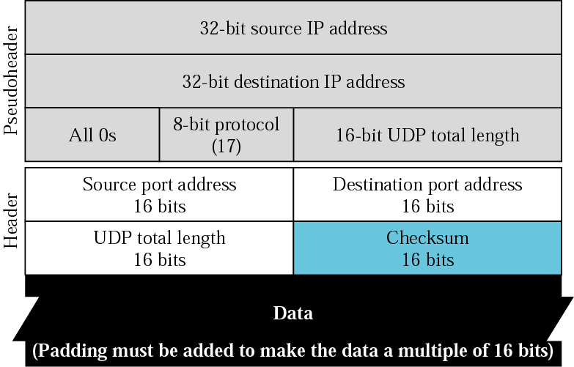
Figure 11.8 Pseudoheader for checksum calculation

Slide 18
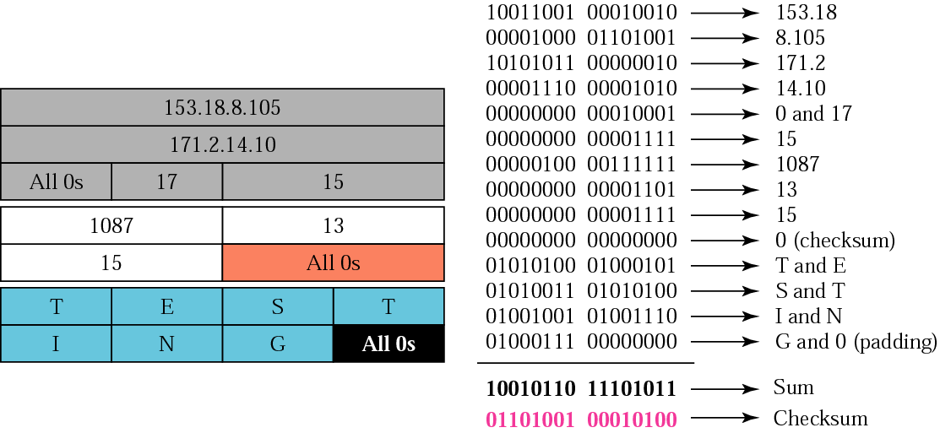
Figure 11.9 Checksum calculation of a simple UDP user datagram

Slide 19
11.4 UDP OPERATION
UDP uses concepts common to the transport layer. These concepts will be discussed here briefly, and then expanded in the next chapter on the TCP protocol.
The topics discussed in this section include:
Connectionless Services
Flow and Error Control
Encapsulation and Decapsulation
Queuing
Multiplexing and Demultiplexing

Slide 20
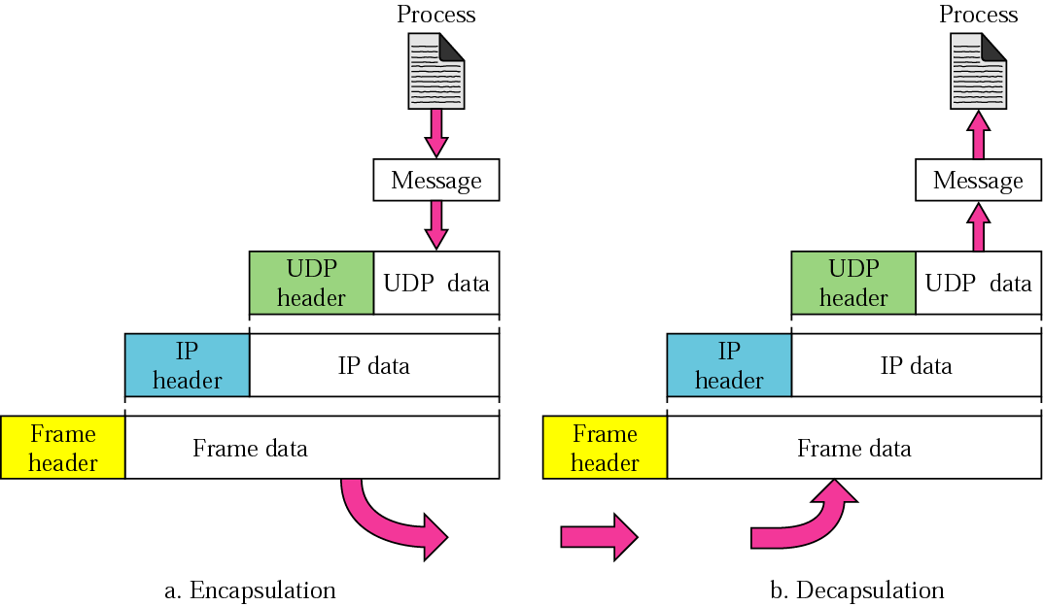
Figure 11.10 Encapsulation and decapsulation

Slide 21
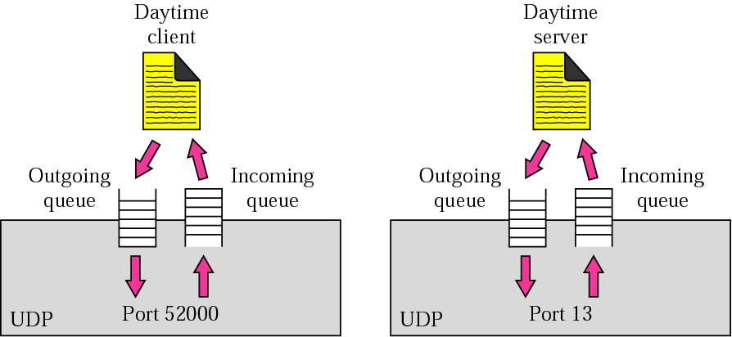
Figure 11.11 Queues in UDP

Slide 22
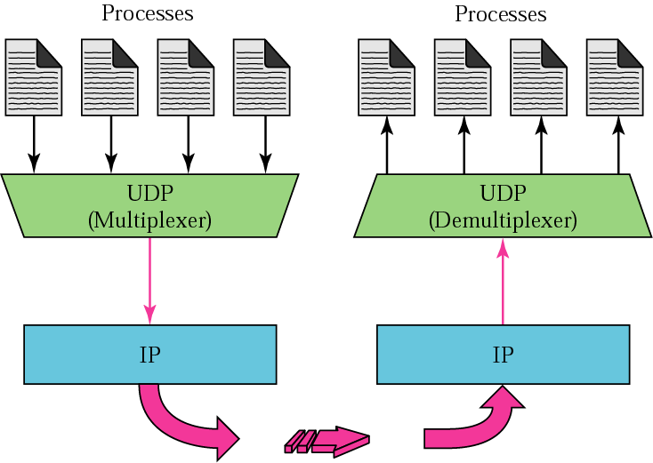
Figure 11.12 Multiplexing and demultiplexing

Slide 23
11.5 USE OF UDP
We discuss some uses of the UDP protocol in this section.

Slide 24
11.6 UDP PACKAGE
To show how UDP handles the sending and receiving of UDP packets, we present a simple version of the UDP package. The UDP package involves five components: a control-block table, input queues, a control-block module, an input module, and an output module.
The topics discussed in this section include:
Control-Block Table
Input Queues
Control-Block Module
Input Module
Output Module

Slide 25
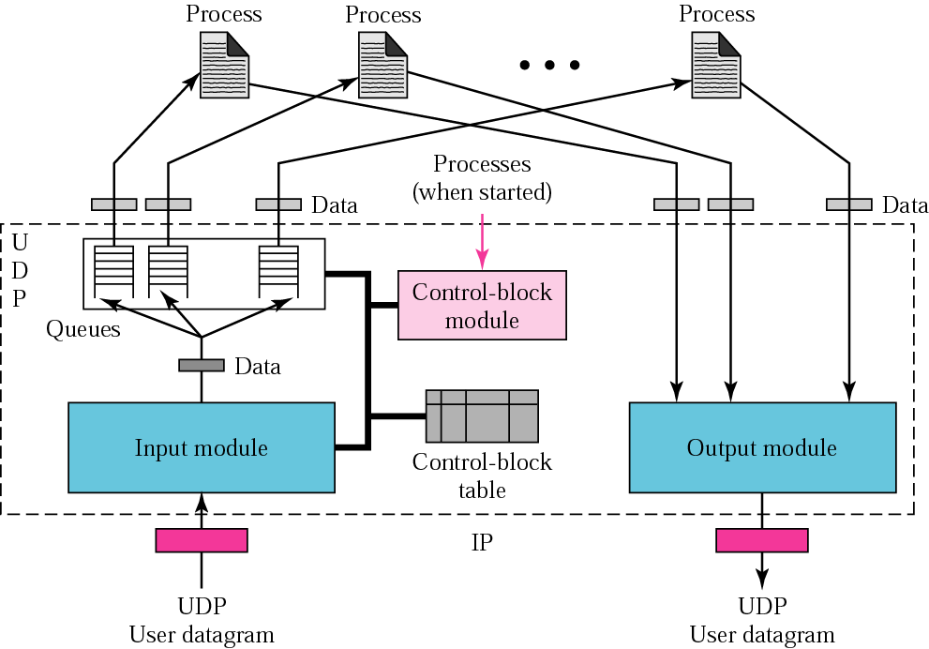
Figure 11.13 UDP design

Slide 26
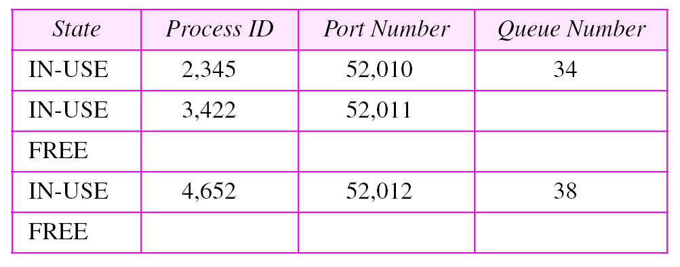
Table 11.2 The control-block table at the beginning of examples

Slide 27
Example 2
The first activity is the arrival of a user datagram with destination port number 52,012. The input module searches for this port number and finds it. Queue number 38 has been assigned to this port, which means that the port has been previously used. The input module sends the data to queue 38. The control-block table does not change.

Slide 28
Example 3
After a few seconds, a process starts. It asks the operating system for a port number and is granted port number 52,014. Now the process sends its ID (4,978) and the port number to the control-block module to create an entry in the table. The module takes the first FREE entry and inserts the information received. The module does not allocate a queue at this moment because no user datagrams have arrived for this destination (see Table 11.3).
See Next Slide

Slide 29
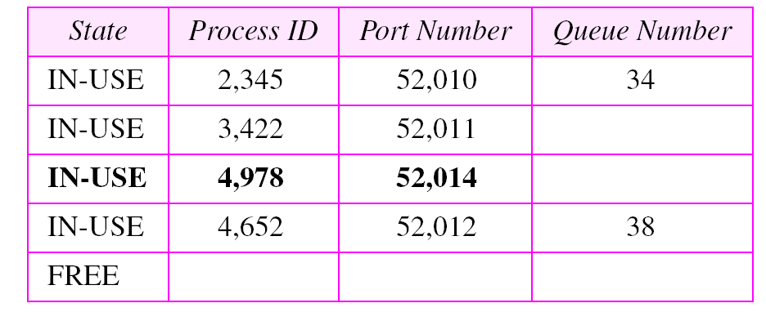
Table 11.3 Control-block table after Example 3

Slide 30
Example 4
A user datagram now arrives for port 52,011. The input module checks the table and finds that no queue has been allocated for this destination since this is the first time a user datagram has arrived for this destination. The module creates a queue and gives it a number (43). See Table 11.4.
See Next Slide

Slide 31
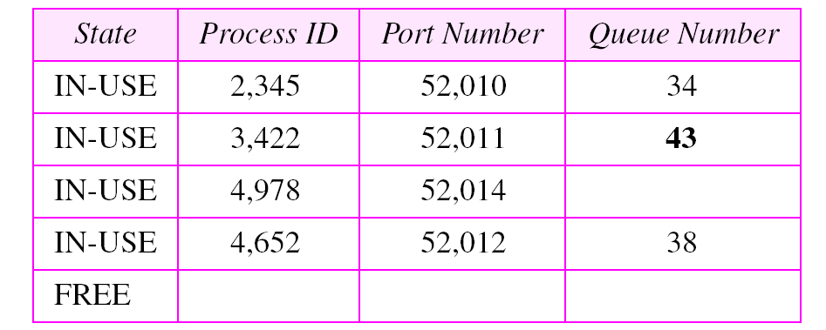
Table 11.4 Control-block after Example 4

Slide 32
Example 5
After a few seconds, a user datagram arrives for port 52,222. The input module checks the table and cannot find an entry for this destination. The user datagram is dropped and a request is made to ICMP to send an “unreachable port” message to the source.

